Slide 1
Business Background
Sören Böttner

Slide 2
Business Background Documentation
XDIS Sharepoint:
“Developer Wiki” – “XDIS Business Background”
Direct link:
https://gsep.daimler.com/confluence/display/XDISDEV/Business+Background
Contains more details...

Slide 3
Project
Project
Car
Combination of Model Series, Body Variant and Release Date Type
Example 1: S class, sedan, start of series
Example 2: C class, station wagon, change year 2015
Contains ECUs, Networks, ECU Interfaces
Platform
Groups similar Projects
Examples: Smart, VAN, STAR 2

Slide 4
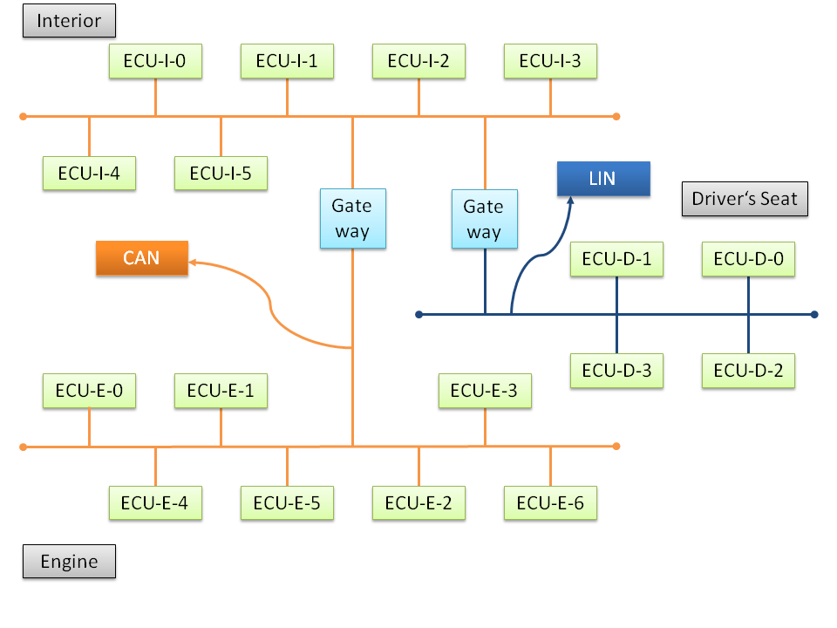
Networks and ECUs
Default Shape
Default Text
Default Line
Notes:
Network (= bus):
different technologies (CAN, CAN FD, LIN, FlexRay, Ethernet) with different advantages/disadvantages
Further separation of networks to reduce bus load and to increase safety
ECU Interfaces connect Networks with ECUs. At the ECU Interfaces it is defined which data is sent/received.
Sent data received by all ECUs on the network, selected data routed by Gateways to other networks

Slide 5
Abstractions of Network
Network Type
Chassis
Network Context
Chassis 2011_16a
Chassis 212/207 2014 29a
…
“150%”
Network
Chassis 204 12/1
Chassis 207 12/1
FR-Chassis 212 2015
many more…
“120%”
 | Body | Chassis | … | …
Frame 1 | s
Frame 2 | r | s
… |  |  | r
ECU Communication Excel Export having Network Types as columns:
Notes:
Abstractions are used to aggregate data in Excel exports
Network Type: abstract name (highest level, easy to understand)
Network Context: collection of (similar) networks of different model series / projects which are maintained together; 150% means that all contained networks contain more ECUs than a single Network, i.e. more variants of the ECUs
Network: specific for a certain project; 120% means that it contains more ECUs than a real car on the street (e.g. Diesel and Petrol variant of the engine ECU)
Real network names are even longer
Chassis Network has data like Wheel State or Brake System State

Slide 6
Abstractions of ECU
ECU Type
RVC
RVC = Rear View Camera
ECU Class
RVC STAR 2
RVC 166/204
ECU (Communication)
RVC STAR 2 V1 2013
RVC 204 V4 2011
RVC 166/204 V8 2013
 | RVC | HUD | TGW | …
Frame 1 | s | r | r
Frame 2 | r | s |  | r
… | r |  | s
Network Excel Export having ECU Types as columns:
Notes:
Abstractions are used to aggregate data in Excel exports
ECU Type: abstract name (highest level, easy to understand)
ECU Class: a bit more specific than ECU Type
ECU Communication: specific for a few projects
166 and 204 are model series
V1, V4, V8 are variants of ECU Communications
Real ECU Communication names are often even longer

Slide 7
Routing
Routing means that data is received from a Network via an ECU Interface and is sent to a different Network via another ECU Interface.
Frame Routing (not supported by AUTOSAR)
A whole Frame routed
PDU Routing
A PDU out of a Frame is routed into the same or different Frame
Frame context is important (receive / send Frame is required)
Signal Routing
A Signal out of a Frame is routed into the same or different Frame
Frame context is important (receive / send Frame is required)
Frame/PDU/Signal
Gateway
Frame/PDU/Signal
I1
I2
Network 1
Network 2
ECU Interfaces

Slide 8
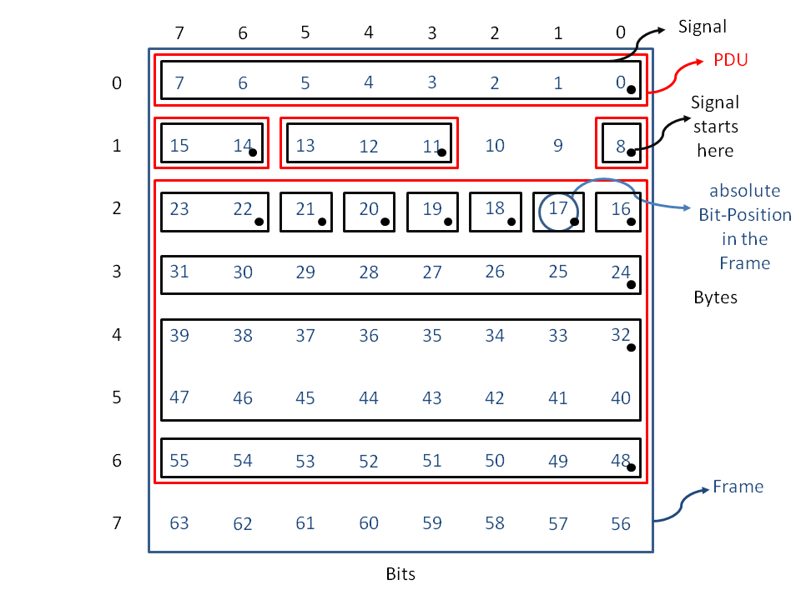
Frames, PDUs, Signals
Notes:
Frame has a fix structure of contained Signals. Signals are the logical information which is transferred. They have got a DataType which defines how their data is to be interpreted.
The receiver recognizes the frame by its Frame ID (CAN/LIN), its schedule table entry (FlexRay) or the port (Ethernet) and this way knows the structure of its content.
Absolute Bit Position vs. Bit/Byte position.
A Frame is always sent completely over the bus.
Default Values – used if no value has been defined for a certain Signal.
Signal Packets: Parts of a PDU only used before AUTOSAR (i.e. in DBKOM)

Slide 9
Data Types
Different types
Integer
Boolean
Enum – for digital values
Scaled – for encoding of physical values, also allows additional digital values
Record – for structured DataTypes – its record elements again are of a certain DataType each
Array – its sub data type defines the types of the array elements
Example for Digital Values
0 Off
1 Idle
2 Active
Example for Physical Value encoding
Temperature range: -50 to 50 °C
Resolution: 0.1 °C
Scaling formula: 0.1x-50
Norm. values (= internal values): 0 to 1000
Bit length of Data Type (and Signal): 10
Mapped value examples: -50 °C ➔ 0 0 °C ➔ 500 50 °C ➔ 1000

Slide 10
Hierarchy of Software Components (SWCs)
Compositions (SWCs) may contain other SWCs
There is a strict hierarchy of SWCs, i.e. their hierarchy level defines where they need to be put
ECU has one ECU Composition assigned containing all Component Contributions of the ECU
Networking Project has one Vehicle Composition assigned containing all System Compositions of the vehicle
Each Component Contributions is mapped to one ECU Composition and to one System Composition
Component Contributions may contain Atomic SWCs or other Compositions (no hierarchy level)
Vehicle Composition
ECU Composition
System Composition
Component Contribution
(Atomic or other Composition)
Notes:
System = main function, e.g. Interior Light, whose functionality is distributed to different ECUs

Slide 11
Mapping of Component Contributions to ECU Compositions and System Compositions
Vehicle Composition (referenced by Networking Project)
System Composition (referenced by Networking Platform)
ECU Composition
ECU Composition
Component Contribution
Component Contribution
System Composition
Component Contribution
Component Contribution
Assembly Connector
Delegation Connector
Notes:
Component Contributions are mapped differently to ECU Compositions and System Compositions. Two Component Contributions of a System Composition usually belong to different ECU Compositions. Two Component Contributions of an ECU Composition usually belong to different System Compositions.
Connectors connect ports of SWCs:
Assembly Connectors: Connect components of the same hierarchy level – defined at the composition containing these components
Delegation Connector: Connect a composition with its contained component – delegates functionality to the parent or sub component
In the example the ECU Composition (blue) defines an Assembly Connector between two Component Contributions (blue connector). The System Composition (red) defines an Assembly Connector between two Component Contributions and several Delegation Connectors between itself and a contained Component Contribution (red connectors). The Vehicle Composition (green) defines an Assembly Connector to connect its contained System Compositions. And these Ports are delegated by the System Compositions to the Component Contributions. So, while in the ECU Composition the Component Contributions are directly connected, the same connection is done for the System Compositions using three Connectors – first by delegating to the System Compositions and then by assembling the System Compositions.

Slide 12
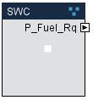
SWC Ports, SWC Interfaces
SWC Ports / SWC Interfaces represent the external interface of an SWC
SWC Ports are instances of SWC Interfaces
Provided Port: provides data / functionality
Required Port: requires data / functionality
SWC Interface types:
SWC Interface Sender Receiver: data (SWC Data Elements) is sent/received – in most cases over the bus
SWC Interface Client Server: allows calls of operations (SWC Operation)
SWC Interface Calibration Parameter (CalPrm): allows to set calibration parameters (SWC Parameter) for components – used to configure SWCs
SWC Interface Mode Declaration: used to define and switch between different modes (rarely used)
Example
Provided Port “P_Fuel_Rq” for SWC Interface Sender Receiver “IG_Fuel_Rq” having SWC Data Element “Fuel_Rq” means that the SWC sends the Data Element “Fuel_Rq” via this port (which is usually mapped to Signal or Signal Group which is sent across the network)

Slide 13
SWC Communication Mapping (1/2)
SWC Data Elements are mapped to Signals or Signal Groups and this way connect the data in the SWC with the data on the network
If the ECU Interface receives a Signal the AUTOSAR RTE put its data into the mapped SWC Data Element where the software may access it.
If the software puts data into the SWC Data Element the AUTOSAR RTE passes this to the mapped signal which is then sent by the ECU Interface
Simple Mapping vs. Complex Mapping
Simple Mapping: an SWC Data Element having a simple Data Type (e.g. Boolean) is mapped to a Signal
Complex Mapping: an SWC Data Element having a Record Data Type is mapped to a Signal Group, the record elements are mapped to the Signals of the Signal Group
The mapping is defined at the SWC Data Element and applies to all Ports of Component Contribution SWCs using it (unless the port explicitly ignores it)
Notes:
AUTOSAR RTE: Runtime Environment
SWC Communication Mappings are only defined for SWCs of hierarchy level Component Contribution – in the AUTOSAR export this data is generated/aggregated for the ECU Compositions
Local mappings are used, if a single SWC Data Element is mapped to different Signals by different SWCs, e.g. SWC Data Element WheelState is mapped to Signal WheelState_FL, WheelState_FR, WheelState_RL or WheelState_RR by the four SWCs having a Common Component Type (i.e. have common port definitions). Note: FL =Front Left, FR = Front Right, RL = Rear Left, RR = Rear Right

Slide 14
SWC Communication Mapping (2/2)
Example of a Complex Mapping
Fuel_Rq is the request to start the fuel pump with a certain pressure
SWC Interface
IG_Fuel_Rq
Fuel_Rq
Signal Group (part of Frame EngineCtrl_Stat)
SWC Data Element
Fuel_Rq
Data Type (Record)
REC_Fuel_Rq
Fuel_Pump_On_Rq
Fuel_Pump_On_Rq
Record Elements
Signals
Fuel_Pressure_Rq
Fuel_Pressure_Rq

Slide 15
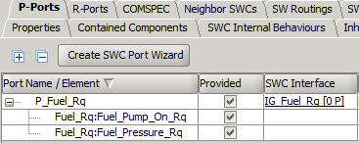
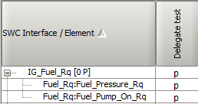
SWC Port Communication Details
Define, which parts of the Ports are actually used (i.e. provided/required)
“Parts” refers to combinations of SWC Data Elements and Record Elements
In Object Editor:
SWC Interface
IG_Fuel_Rq
SWC Data Element
Fuel_Rq
Data Type (Record)
REC_Fuel_Rq
In P/R Matrix:
Fuel_Pump_On_Rq
Record Elements
Fuel_Pressure_Rq
Notes:
Purposes of this definitions (which are not needed by AUTOSAR):
Documentation
Signal Group Degradation (reduce SWC Interfaces and Signal Groups to those parts / sub elements which are actually used and this way increase backwards compatibility of later extensions of these SWC Interfaces / Signal Groups by additional elements)
Special internal logic: If all parts / details of a port are selected, internally no SWC Port Communication Details are stored for the Port to reduce the total amount of data in the database. But this makes it a bit harder to understand and always requires a special handling of this case in the implementation.

Slide 16
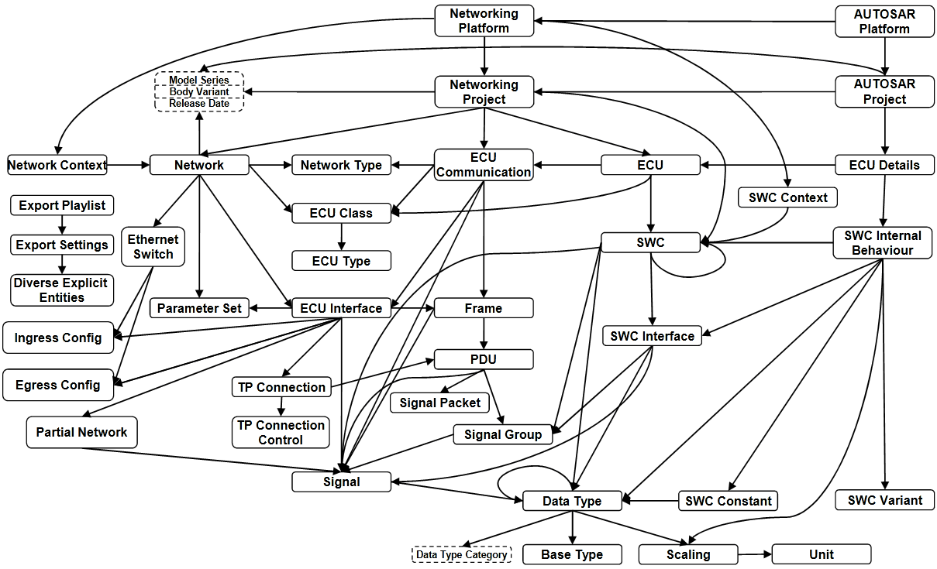
Artificial Object Separation in XDIS due to the Process
Platform: Networking Platform, AUTOSAR Platform
Project: Networking Project, AUTOSAR Project
ECU: ECU Communication, ECU, ECU Details
(SWC: SWC, SWC Internal Behaviour)
From the business point of view consider them as a single object
Notes:
In XDIS several objects are artificially split / separated into several objects just because of the process, i.e. the users work with and release the data.
Example: The communication data (e.g. Networking Project) shall be released earlier than the SWC Internal Behaviours are finished.
Note: SWC and SWC Internal Behaviour are also separated by AUTOSAR, not only by XDIS

